Slide 1


Unit 4
Transaction Processing
Prof. Vishwa Dabhi, Prof. Atul Kumar, Assistant Professor
Computer science and Engineering

Slide 2




CHAPTER-4
Transaction Processing

Slide 3

Transaction
Collection of operations that form a single logical unit of work are called transactions.
A transaction is a unit of program execution that accesses and possibly updates various data items.
A transaction is a logical unit of work that contains one or more SQL statements.
Usually, a transaction is initiated by a user program written in high-level data-manipulation language or programming language, where it is delimited by statements of the form begin transaction and end transaction.

Slide 4
ACID property
To ensure integrity of the data, database system must maintain the following properties:
Atomicity
Consistency
Isolation
Durability

Slide 5
ACID property
Atomicity: Either all operations of the transaction are reflected properly in the database, or none are.
Consistency: Execution of a transaction in isolation i.ie., with no other transaction executing concurrently, preserves the consistency of the database.
Isolation: Even though multiple transactions may execute concurrently, the system guarantees that, for every pair of transactions Ti and Tj, it appears to Ti that either Tj finished execution before Ti started or Tj started execution after Ti finished. Thus, each transaction is unaware of other transactions executing concurrently in the system.
Durability: After a transaction completes successfully, the changes it has made to the database persist, even if there are system failures.

Slide 6
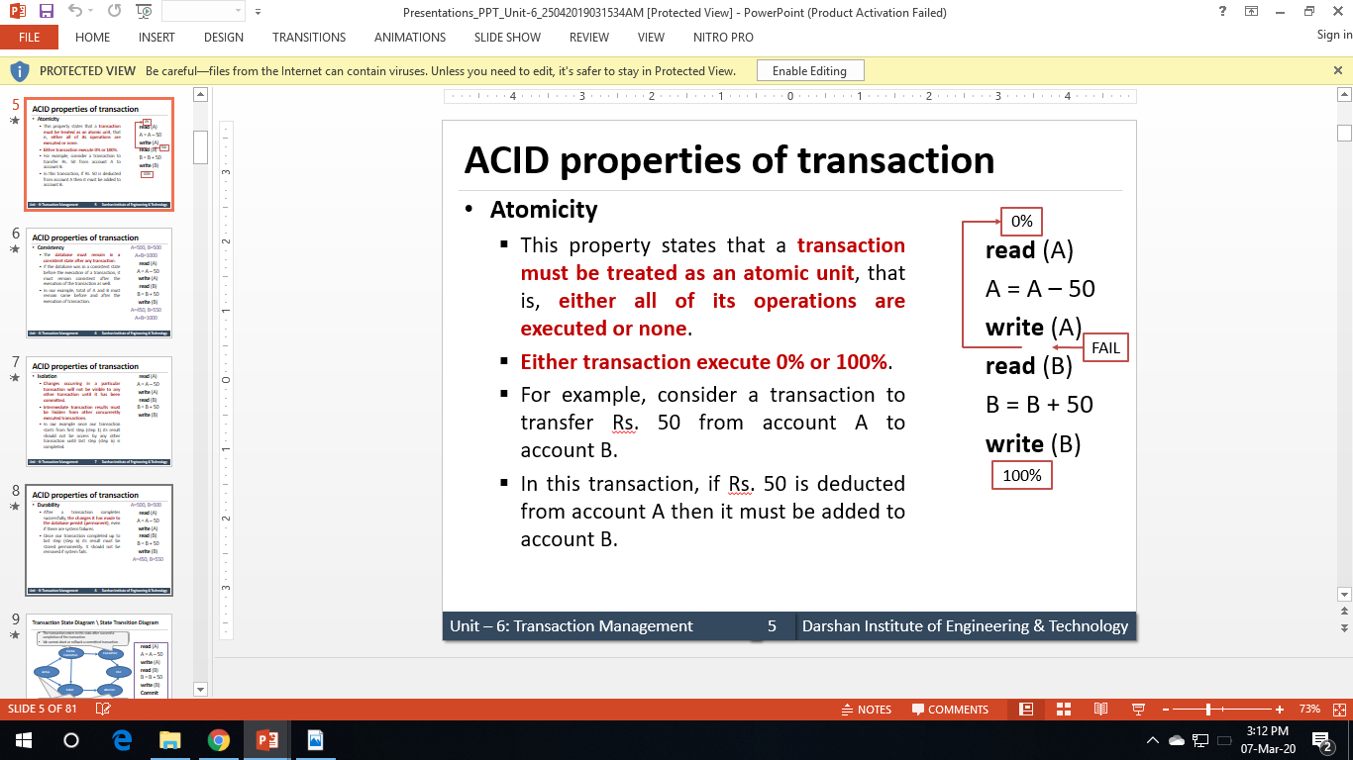
Atomicity
This property states that a transaction must be treated as an atomic unit, i.e., either all of its operations are executed or none.
For example, consider a transaction to transfer Rs. 50 from account A to account B.
In this transaction, if Rs. 50 is deducted from account A then it must be added to account B.

Slide 7
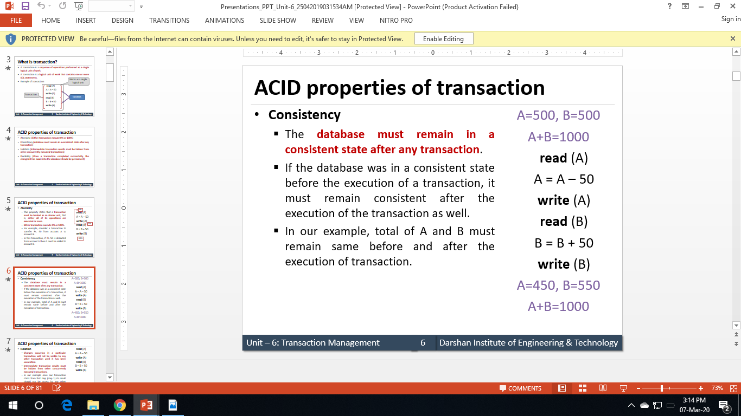
Consistency
The database must remain in a consistent state after any transaction.
If the database was in a consistent state before the execution of a transaction, it must remain consistent after the execution of the transaction as well.
In our example, total of A and B must remain same before and after the execution of transaction.

Slide 8
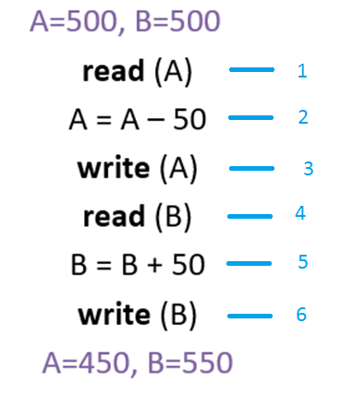
Isolation
Although multiple transactions may execute concurrently, each transaction must be unaware of other concurrently executing transactions.
Intermediate transaction results must be hidden from other concurrently executed transactions.
In the example once your transaction start from step one its result should not be accessed by any other transaction until last step (step 6) is completed.

Slide 9
Durability
After a transaction completes successfully, the changes it has made to the database persist(permanent), even if there are system failures.
Once our transaction is completed up to last step (step 6) its result must be stored permanently. It should not be removed if the system fails.

Slide 10
Transaction State
A transaction may not always complete its execution successfully, such transaction is termed aborted.
Once the changes caused by an aborted transaction have been undone, we say that the transaction has been rolled back.
A transaction that completes its execution successfully is said to be committed.
Once the transactions are committed, we cannot undo its effects by aborting it. The only way to undo the effects of a committed transaction is to execute a compensating transaction.

Slide 11
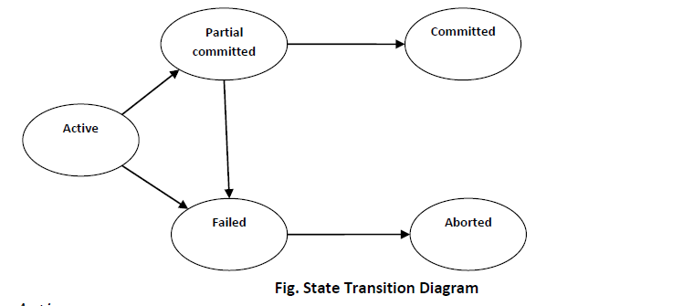
Transaction State
Image source : Google

Slide 12
Transaction State
A transaction must be in one of the following states:
Active, the initial state; the transaction stays in this state while it is executing.
Partially committed, after the final statement has been executed.
Failed, after the discovery that normal execution can no longer proceed.
Aborted, after the transaction has been rolled back and the database has been restored to its state prior to the start of the transaction.
Committed, after successful transaction.

Slide 13
The Transaction Log
Keeps track of all transactions that update the database. It contains:
A record for the beginning of transaction
For each transaction component (SQL statement)
Type of operation being performed (update, delete, insert)
Names of objects affected by the transaction (the name of the table)
“Before” and “after” values for updated fields
Pointers to previous and next transaction log entries for the same transaction
The ending (COMMIT) of the transaction
This increases processing overhead but the advantage is the ability to restore a corrupted database

Slide 14
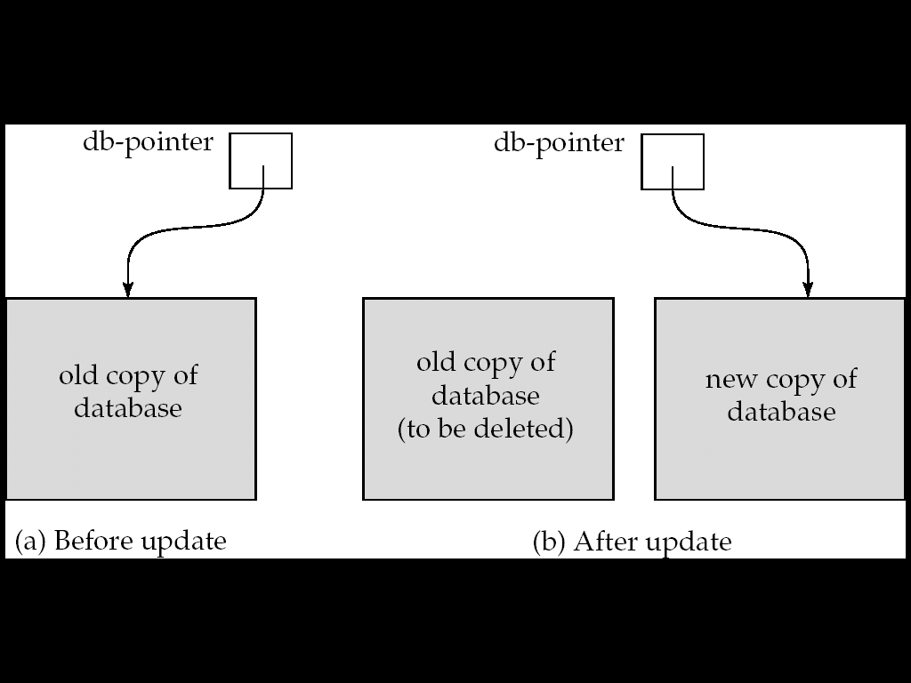
Implementation of Atomicity and Durability
The recovery-management component of a database system implements the support for atomicity and durability.
E.g. the shadow-database scheme:
all updates are made on a shadow copy of the database
db_pointer is made to point to the updated shadow copy after
the transaction reaches partial commit and
all updated pages have been flushed to disk.
Image source : Google

Slide 15
Implementation of Atomicity and Durability
db_pointer always points to the current consistent copy of the database.
In case transaction fails, old consistent copy pointed to by db_pointer can be used, and the shadow copy can be deleted.
The shadow-database scheme:
Assumes that only one transaction is active at a time.
Assumes disks do not fail
Useful for text editors, but
extremely inefficient for large databases (why?)
- Variant called shadow paging reduces copying of data, but is still not practical for large databases
Does not handle concurrent transactions

Slide 16
Concurrent Executions
Multiple transactions are allowed to run concurrently in the system. Advantages are:
increased processor and disk utilization, leading to better transaction throughput
E.g. one transaction can be using the CPU while another is reading from or writing to the disk
reduced average response time for transactions: short transactions need not wait behind long ones.
Concurrency control schemes – mechanisms to achieve isolation
that is, to control the interaction among the concurrent transactions in order to prevent them from destroying the consistency of the database

Slide 17
Schedules
Schedule – a sequences of instructions that specify the chronological order in which instructions of concurrent transactions are executed
a schedule for a set of transactions must consist of all instructions of those transactions
must preserve the order in which the instructions appear in each individual transaction.
A transaction that successfully completes its execution will have a commit instructions as the last statement
by default transaction assumed to execute commit instruction as its last step
A transaction that fails to successfully complete its execution will have an abort instruction as the last statement

Slide 18
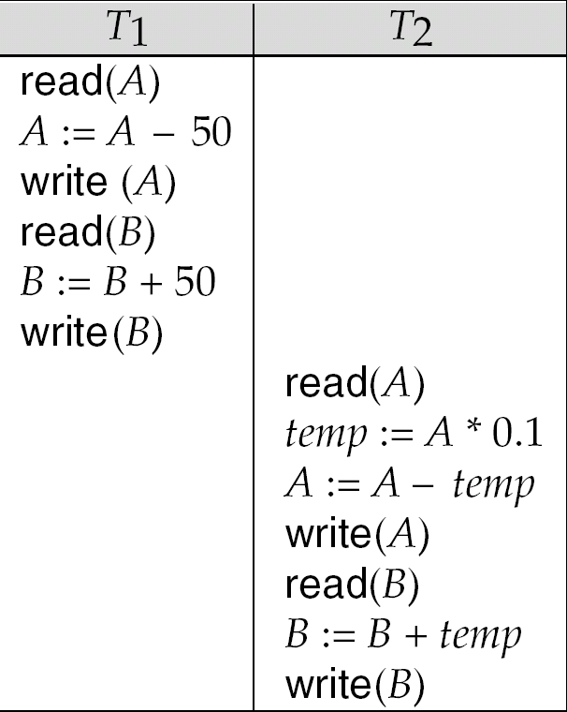
Schedule - 1
Let T₁ transfer $50 from A to B, and T₂ transfer 10% of the balance from A to B.
A serial schedule in which T₁ is followed by T₂ :
Image source : Korth

Slide 19
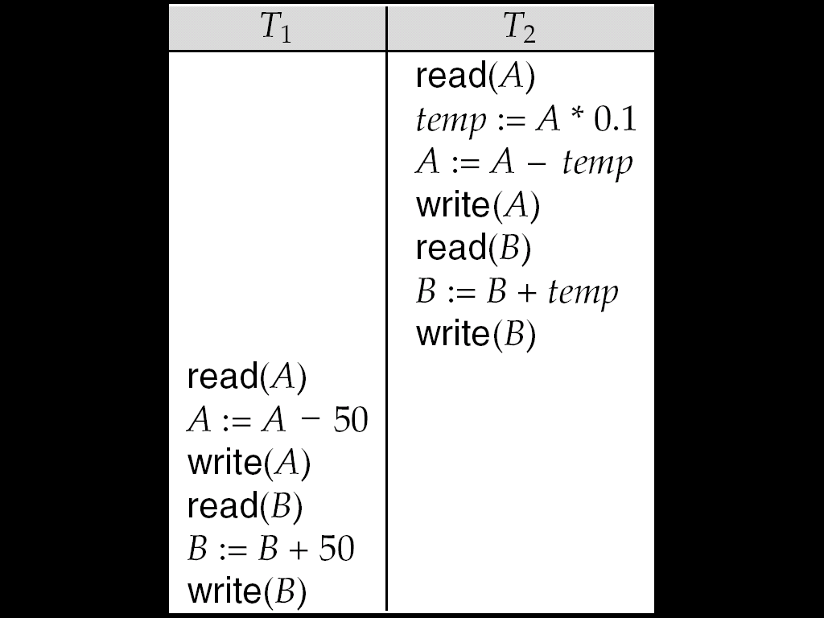
Schedule - 2
A serial schedule where T₂ is followed by T₁
Image source : Korth

Slide 20
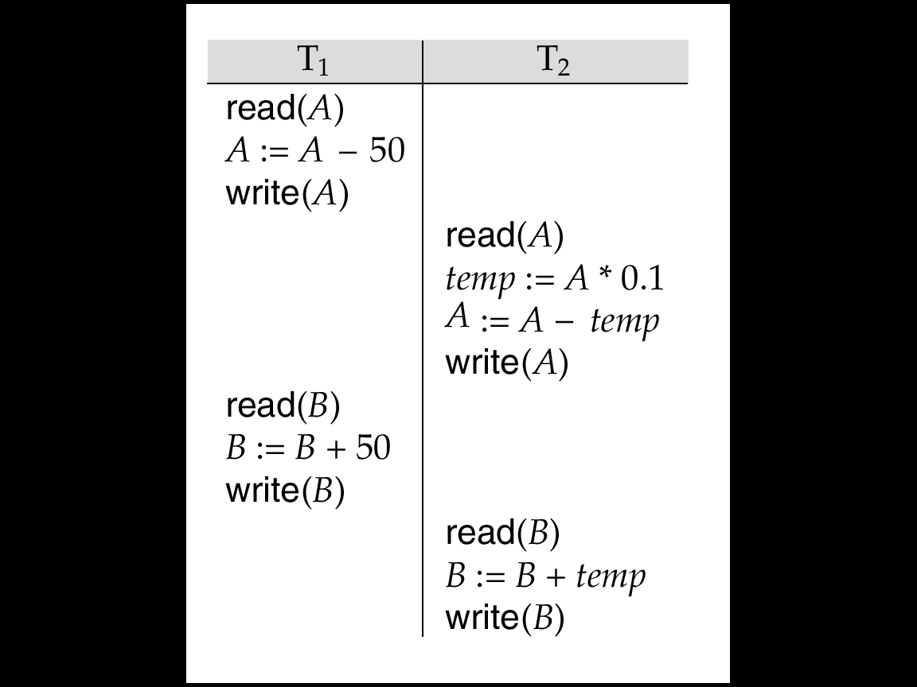
Schedule - 3
Let T₁ and T₂ be the transactions defined previously.
The following schedule is not a serial schedule, but it is equivalent to Schedule 1.
Image source : Korth

Slide 21
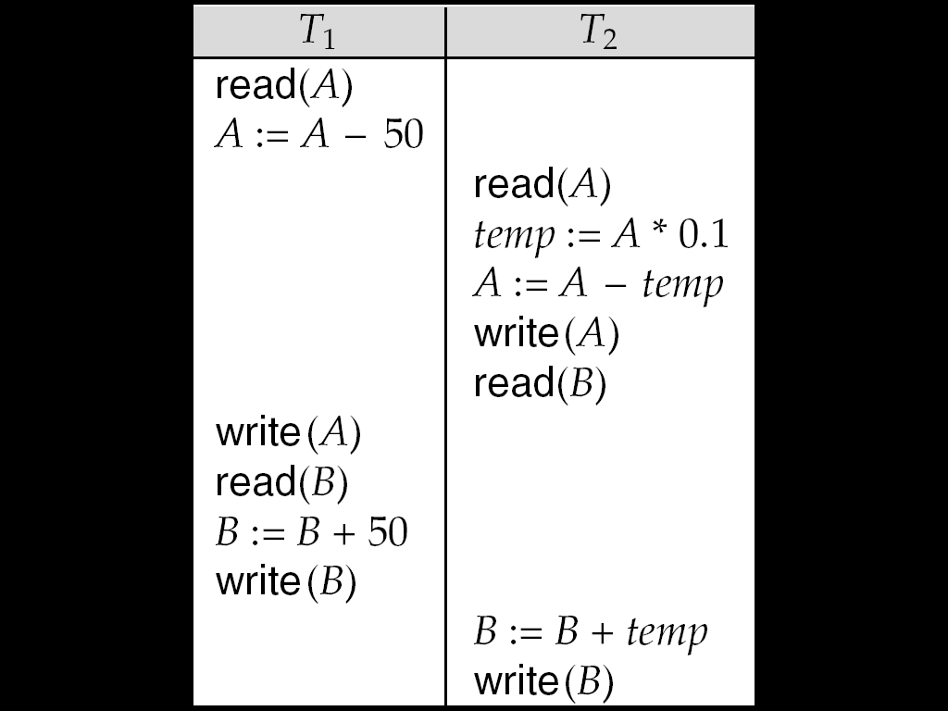
Schedule - 4
The following concurrent schedule does not preserve the value of (A + B).
Image source : Korth

Slide 22
Serializability
Basic Assumption – Each transaction preserves database consistency.
Thus serial execution of a set of transactions preserves database consistency.
A (possibly concurrent) schedule is serializable if it is equivalent to a serial schedule. Different forms of schedule equivalence give rise to the notions of:
1. conflict Serializability
2. view Serializability

Slide 23
Serializability
Simplified view of transactions
We ignore operations other than read and write instructions
We assume that transactions may perform arbitrary computations on data in local buffers in between reads and writes.
Our simplified schedules consist of only read and write instructions.

Slide 24
Conflicting Instructions
Instructions l_{i} and l_{j} of transactions T_{i} and T_{j} respectively, conflict if and only if there exists some item Q accessed by both l_{i} and l_{j}, and at least one of these instructions wrote Q.
1. l_{i} = read(Q), l_{j} = read(Q). l_{i} and l_{j} don’t conflict. 2. l_{i} = read(Q), l_{j} = write(Q). They conflict. 3. l_{i} = write(Q), l_{j} = read(Q). They conflict 4. l_{i} = write(Q), l_{j} = write(Q). They conflict

Slide 25
Conflict Serializability
If a schedule S can be transformed into a schedule S´ by a series of swaps of non-conflicting instructions, we say that S and S´ are conflict equivalent.
We say that a schedule S is conflict serializable if it is conflict equivalent to a serial schedule

Slide 26
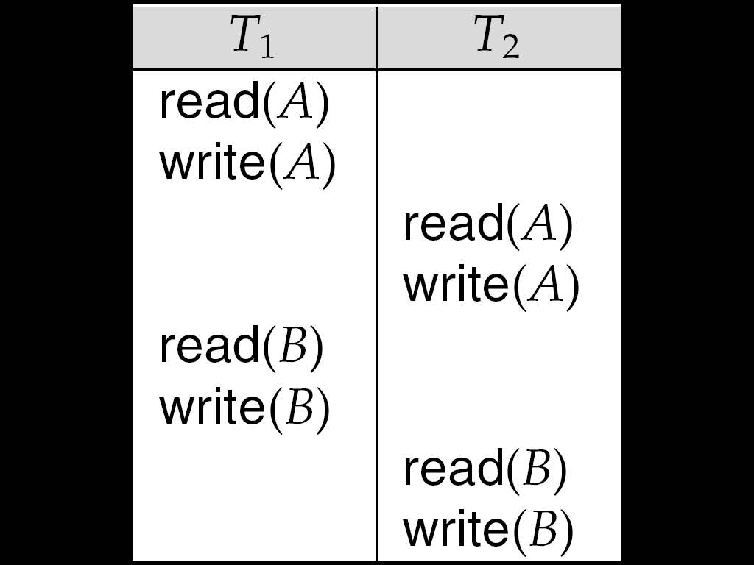
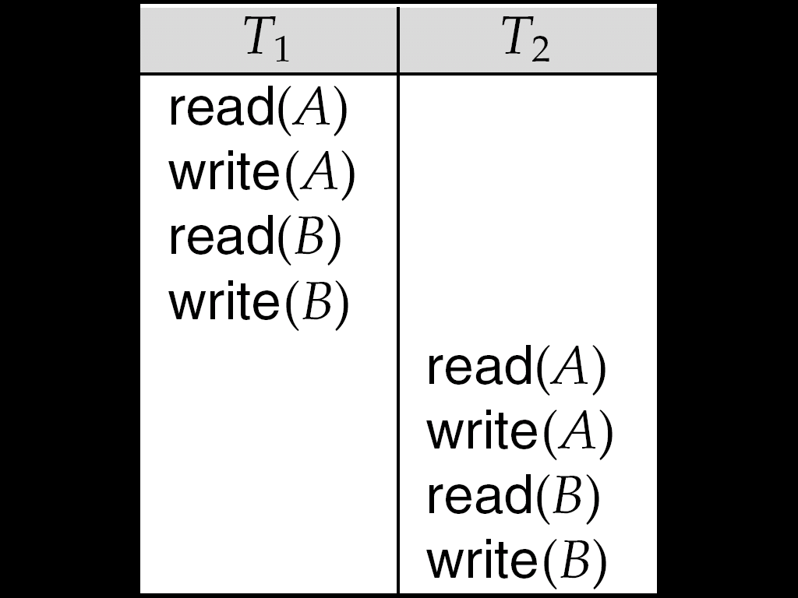
Conflict Serializability
Schedule 3 can be transformed into Schedule 6, a serial schedule where T₂ follows T₁, by series of swaps of non-conflicting instructions.
Therefore Schedule 3 is conflict serializable.
Schedule 3
Schedule 6
Image source : Korth

Slide 27
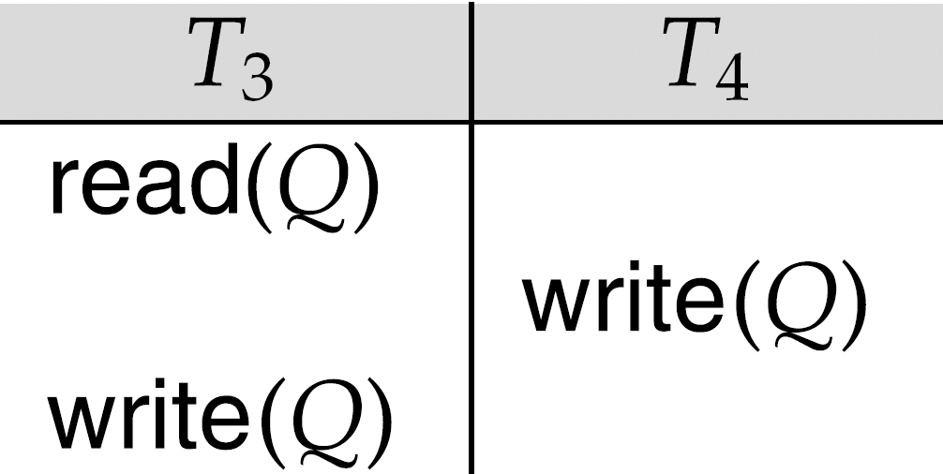
Conflict Serializability
Example of a schedule that is not conflict serializable:
We are unable to swap instructions in the above schedule to obtain either the serial schedule < T₃, T₄ >, or the serial schedule < T₄, T₃ >.
Image source : Korth

Slide 28
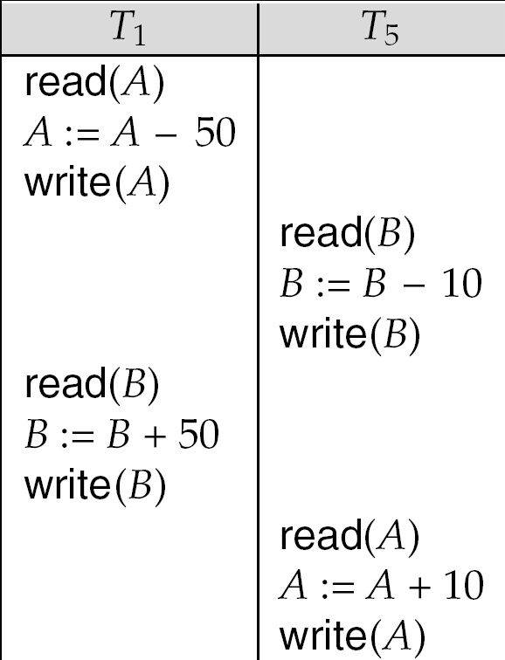
Other Notions of Serializability
The schedule below produces same outcome as the serial schedule < T₁, T₅ >, yet is not conflict equivalent or view equivalent to it.
Determining such equivalence requires analysis of operations other than read and write.
Image source : Korth

Slide 29
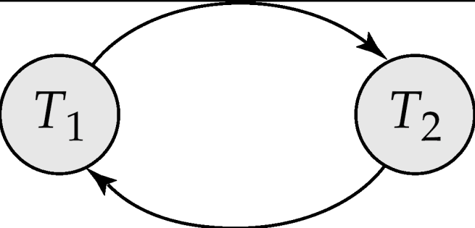
Testing for Serializability
Consider some schedule of a set of transactions T₁, T₂, ..., T_{n}
Precedence graph — a direct graph where the vertices are the transactions (names).
We draw an arc from T_{i} to T_{j} if the two transaction conflict, and T_{i} accessed the data item on which the conflict arose earlier.
We may label the arc by the item that was accessed.
Example 1
Image source : Google

Slide 30
Example Schedule (Schedule A) + Precedence Graph
T₁ T₂ T₃ T₄ T₅ read(X) read(Y) read(Z) read(V) read(W) read(W) read(Y) write(Y) write(Z) read(U) read(Y) write(Y) read(Z) write(Z)
read(U) write(U)
T₁
T₂
T₄
T₃
Image source : Google

Slide 31
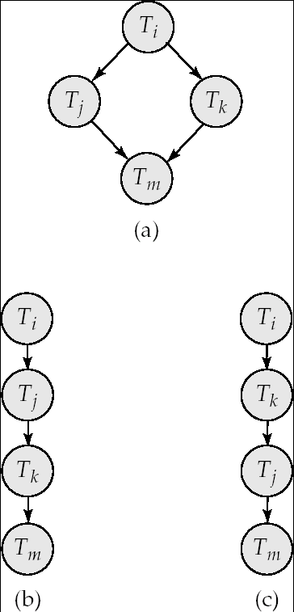
Test for Conflict Serializability
A schedule is conflict serializable if and only if its precedence graph is acyclic.
Cycle-detection algorithms exist which take order n² time, where n is the number of vertices in the graph.
(Better algorithms take order n + e where e is the number of edges.)
If precedence graph is acyclic, the Serializability order can be obtained by a topological sorting of the graph.
This is a linear order consistent with the partial order of the graph.
For example, a Serializability order for Schedule A would be T₅ → T₁ → T₃ → T₂ → T₄
Are there others?
Image source : Google

Slide 32
View Serializability
Let S and S´ be two schedules with the same set of transactions. S and S´ are view equivalent if the following three conditions are met, for each data item Q,
If in schedule S, transaction T_{i} reads the initial value of Q, then in schedule S’ also transaction T_{i} must read the initial value of Q.
If in schedule S transaction T_{i} executes read(Q), and that value was produced by transaction T_{j} (if any), then in schedule S’ also transaction T_{i} must read the value of Q that was produced by the same write(Q) operation of transaction T_{j} .
The transaction (if any) that performs the final write(Q) operation in schedule S must also perform the final write(Q) operation in schedule S’.
As can be seen, view equivalence is also based purely on reads and writes alone.

Slide 33
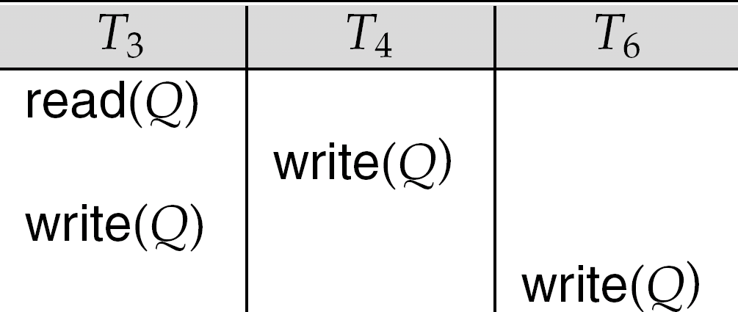
View Serializability
Without read , if read perform is ‘Blind Write’
If there is no blind writes and if schedules is not CS than schedule is not serializable
If there is blind writes and if schedules is not CS than check for view serializable (VS).
Every CS is VS but vise versa is not true.
In view we have to check the sequence of only read.
Image source : Korth

Slide 34
View Serializability
A schedule S is view serializable if it is view equivalent to a serial schedule.
Every conflict serializable schedule is also view serializable.
Below is a schedule which is view-serializable but not conflict serializable.
Every view serializable schedule that is not conflict serializable has blind writes.
Image source : Korth

Slide 35
Test for View Serializability
The precedence graph test for conflict Serializability cannot be used directly to test for view Serializability.
Extension to test for view Serializability has cost exponential in the size of the precedence graph.
The problem of checking if a schedule is view serializable falls in the class of NP-complete problems.
Thus existence of an efficient algorithm is extremely unlikely.

Slide 36
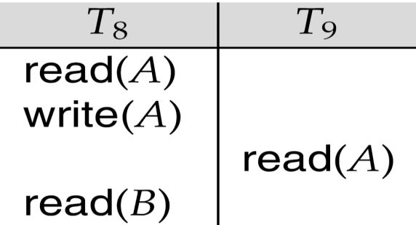
Recoverable Schedules
Need to address the effect of transaction failures on concurrently running transactions.
Recoverable schedule — if a transaction T_{j} reads a data item previously written by a transaction T_{i} , then the commit operation of T_{i} appears before the commit operation of T_{j}.
The following schedule (Schedule 11) is not recoverable if T₉ commits immediately after the read.
If T₈ should abort, T₉ would have read (and possibly shown to the user) an inconsistent database state. Hence, database must ensure that schedules are recoverable.
Image source : Korth

Slide 37
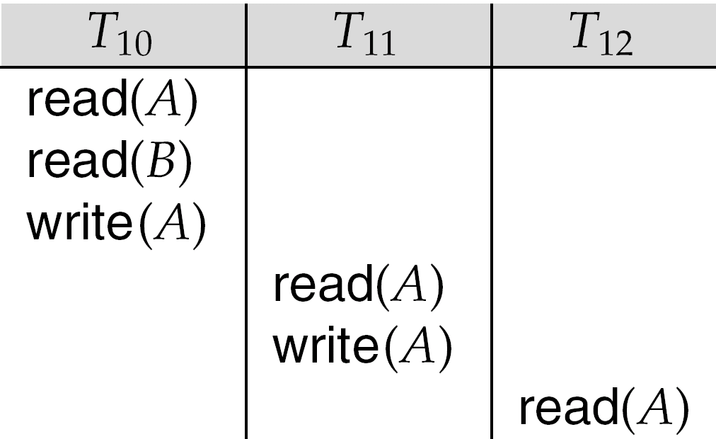
Cascading Rollbacks
Cascading rollback – a single transaction failure leads to a series of transaction rollbacks. Consider the following schedule where none of the transactions has yet committed (so the schedule is recoverable). If T₁₀ fails, T₁₁ and T₁₂ must also be rolled back.
Can lead to the undoing of a significant amount of work.
Image source : Korth

Slide 38
Cascadeless Schedules
Cascadeless schedules — cascading rollbacks cannot occur; for each pair of transactions T_{i} and T_{j} such that T_{j} reads a data item previously written by T_{i}, the commit operation of T_{i} appears before the read operation of T_{j}.
Every cascadeless schedule is also recoverable
It is desirable to restrict the schedules to those that are cascadeless

Slide 39
Concurrency Control
To ensure serializability practically use concurrency control protocol.
A database must provide a mechanism that will ensure that all possible schedules are
either conflict or view serializable, and
are recoverable and preferably cascadeless
A policy in which only one transaction can execute at a time generates serial schedules, but provides a poor degree of concurrency
Are serial schedules recoverable/cascadeless?
Testing a schedule for serializability after it has executed is a little too late!
Goal – to develop concurrency control protocols that will assure serializability.

Slide 40
Locking and Time Stamp Based Schedulers
Whenever Multiple transactions are executed concurrently , It is exceptionally important to maintain concurrency between all of the concurrent transactions.
Concurrency Protocols can be used to maintain ACID properties of all transactions and they can be divided into two categories:-
(i) Lock Based Protocol
(ii) Time Stamp based Protocol

Slide 41
Lock Based Protocols
Lock based Protocol provides a mechanism which
Locks are of two types:-
(i) Lock Based Protocol
(ii) Time Stamp based Protocol

Slide 42
Lock Based Protocols (Continued….)
Lock based Protocols provide a mechanism in which any transaction cannot read or write data without suitable lock.
Locks are of two types:-
(i) Binary Locks:- A lock on data items can be in two states only, it will be either locked or unlocked.
(ii) Shared/exclusive:- This type of locking mechanism differentiates the locks based on their uses. If a lock is acquired on a data item to perform a write operation, it is an exclusive lock.

Slide 43
Lock Based Protocols (Continued….)
There are four types of lock protocols available −
(i) Simplistic Lock Protocol
(ii) Pre-claiming Lock Protocol
(iii) Two-Phase Locking 2PL
(iv) Strict Two-Phase Locking

Slide 44
Lock Based Protocols (Continued….)
(i) Simplistic Lock Protocol
(ii) Pre-claiming Lock Protocol
(iii) Two-Phase Locking 2PL
(iv) Strict Two-Phase Locking

Slide 45
Lock Based Protocols (Continued….)
(i) Simplistic Lock Protocol :-
It means lock must be obtained before every “write” operation and after completion of “write” operation transaction must release lock

Slide 46
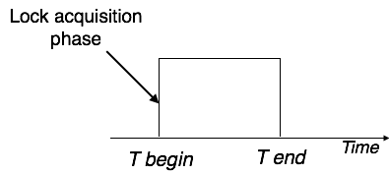
Lock Based Protocols (Continued….)
(ii) Pre-claiming Lock Protocol :-
This Protocol will create a list of database operation and after evaluating them ,Locks will be granted.
If all locks are granted , After completing all the database operations Transaction will release all the locks.

Slide 47
Lock Based Protocols (Continued….)
(iii) Two-Phase Locking 2PL:-
According to this protocol Execution phase will get divided into three parts as follows:
(a) Transaction will need permission to get a lock
(b) Transaction will acquire all the locks
After completion when transaction will release its 1st lock then 3rd phase will start
(c) Now Transaction cannot get a new lock it will release the acquired lock.

Slide 48
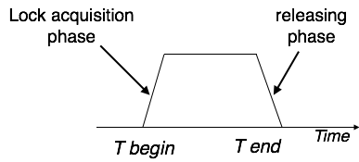
Lock Based Protocols (Continued….)
(iii) Two-Phase Locking 2PL (Continued…..)
This Process of acquiring and releasing lock is called as Growing and Shrinking Phase respectively.
In Growing Phase, Locks will get acquired.
In Shrinking Phase, Locks will get released.

Slide 49
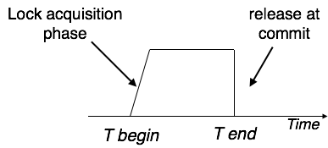
Lock Based Protocols (Continued….)
(iv) Strict Two-Phase Locking :-
According to this protocol Execution phase will get divided into three parts as follows:
(a) Transaction will need permission to get a lock and will acquire all the locks
(b) Now Transaction is not allowed to release any lock until commit (successful transaction) transaction.

Slide 50
Time Stamp Based Protocols (Continued….)
The timestamp-ordering protocol assures serializability between transactions in their conflict read and write operations. This is the liability of the protocol system that the conflict pair of tasks should be completed according to the timestamp values of the transactions.
The timestamp of transaction T_{i} is denoted as TS(T_{i}).
Read time-stamp of data-item X is denoted by R-timestamp(X).
Write time-stamp of data-item X is denoted by W-timestamp(X).

Slide 51
Time Stamp Based Protocols (Continued….)
Timestamp ordering protocol works as follows −
If a transaction Ti issues a read(X) operation −
If TS(Ti) < W-timestamp(X)
Operation rejected.
If TS(Ti) >= W-timestamp(X)
Operation executed.
All data-item timestamps updated.
If a transaction Ti issues a write(X) operation −
If TS(Ti) < R-timestamp(X)
Operation rejected.
If TS(Ti) < W-timestamp(X)
Operation rejected and Ti rolled back.
Otherwise, operation executed.

Slide 52
Multi Version Concurrency Control(MVCC)
MVCC will maintain more than one copy of same data item in order to avoid inconsistency.
Whenever An user will need to update a piece of data in transaction then it will overwrite a copy of data not original data.
MVCC allows POINT IN TIME CONSISTENT view. Read transactions under MVCC typically use a timestamp or Trans ID to decide which state of the database has to read, and read the particular versions of the data that is provided by MVCC.
Due to above approach Read and Write both will get executed at different data items (copies of maintained data).

Slide 53
Multi Version Concurrency Control(MVCC)
MVCC uses timestamp (TS), and incrementing transaction IDs, to attain consistency between transactions. MVCC assures a transaction (T) will never wait for Reading a database object (D) by maintaining several versions of the object. Each version of object D has both a Read Timestamp (RTS) and a Write Timestamp (WTS) which lets a specific transaction T_{i} read the most recent version of the object which precedes the transaction's Read Timestamp RTS(T_{i}).
f transaction T_{i} wants to Write to object D, and there is also another transaction T_{k} happening to the same object, the Read Timestamp RTS(T_{i}) must precede the Read Timestamp RTS(T_{k}), i.e., RTS(T_{i}) < RTS(T_{k}).

Slide 54
Optimistic Concurrency Control(OCC)
Optimistic concurrency control (OCC) is a concurrency control method applied to transactional systems such as relational database management systems and software transactional memory.
OCC provides a concept in which more than one transaction can frequently execute without interfering with each other.
During Execution, transactions utilize data resources without getting locks on those resources. Before committing, each transaction will verify that no other transaction has updated the data it has read. If the check confirms conflicting modifications, the committing transaction rolls back and will get restarted.

Slide 55
Optimistic Concurrency Control(OCC)
Phases of OCC:-
Begin: Save a timestamp by noting the transaction's beginning TS.
Modify: Read database values, and tentatively write changes.
Validate: Check whether other transactions have updated data that currently executed transaction has used (read or written). This includes transactions that completed after this transaction's start time, and optionally, transactions that are still active at validation time.
Commit/Rollback: If there is no conflict, make all changes take effect. If there is a conflict, resolve it.

Slide 56
Database Recovery
DBMS is a extremely complex system where thousands of transactions get executed each second. The resilience and robustness of a DBMS depends on its composite architecture and its underlying hardware and system software. If it fails or crashes during transactions, it is expected that the system would follow some sort of algorithm or techniques to recover lost data.
There are two types of errors can which leads to transaction failure:-
(a) Logical Error:- Code Error or any Query structure error
(b) System Error:- Error occurred due to system failure e.g. Deadlock
System Crash
Disk Failure

Slide 57
Database Recovery (Continued….)
Recovery and Atomicity
When a system crashes, there ma be a possibility that some of the transactions are getting executed and various files are opened for them to update the data items. Transactions are made of different operations, which must be atomic in nature. But according to ACID property of DBMS, atomicity must be maintained throughout the transaction.
Below points must be maintained in case of recovery from failure:-
It should verify the current state of all the transactions, which were in execution
A transaction may be in intermediate of some operation; the DBMS must assure the atomicity of the transaction in this case.
It should verify whether the transaction can be completed now or it needs to be rolled back.
No transactions would be allowed to leave the DBMS in an inconsistent state.

Slide 58
Database Recovery (Continued….)
Recovery and Atomicity
There are two types of techniques, which can help a DBMS in recovering as well as maintaining the atomicity of a transaction −
By Maintaining the logs of each transaction, and writing them onto in some storage and then modify the actual data.
Maintaining shadow paging.

Slide 59
Database Recovery (Continued….)
Log-based Recovery
Log is a list of records which are logically related, which stores the records of activities carried out by a transaction. It is important that the logs are written before actual modification and stored on a stable storage media, which must be safe.
Log-based recovery works as follows −
The log file is kept on a stable storage media.
When a transaction enters the system and starts execution, it writes a log about it.
<T_{n}, Start> When the transaction modifies an item X, it write logs as follows −
<T_{n}, X, V₁, V₂> It reads T_{n} has changed the value of X, from V₁ to V₂.
When the transaction finishes, it logs −
<T_{n}, commit>

Slide 60
Database Recovery (Continued….)
Recovery with Concurrent Transactions
When some transaction are getting executed in parallel, the logs are interleaved. At the moment of recovery, it will become tough to recover system to restore all logs, and then start recover. To ease this situation, most modern DBMS use the concept of 'checkpoints'.
Checkpoint
Checkpoint is a technique where all the previous logs are removed from the system and stored permanently in a storage disk. Checkpoint declares a point before which the DBMS was in consistent state, and all the transactions were committed.

Slide 61
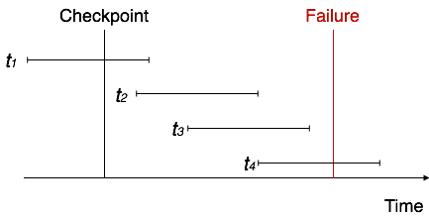
Database Recovery (Continued….)
Recovery with Concurrent Transactions
Transaction behave in following manner when it crashes and then recover:-
The system reads the logs backwards from the end to the last checkpoint.
It maintains two lists, an undo-list and a redo-list.
If the recovery system sees a log with <T_{n}, Start> and <T_{n}, Commit> or just <T_{n}, Commit>, it puts the transaction in the redo-list.
If the recovery system sees a log with <T_{n}, Start> but no commit or abort log found, it puts the transaction in undo-list.

Slide 62


www.paruluniversity.ac.in

